Slide 1
Digital Evidence Integration
Elliot Harkavy, BWC TTA Technology Advisor, CNA
Officer Scott Roth,, Montgomery County, Maryland , Police Department
Suzy Renauer, Montgomery County, Maryland, Police Department
Craig D. Uchida, Ph.D., President, Justice & Security Strategies, Inc.
,
This material was supported by Grant No. 2015-DE-BX-K002 awarded by the Bureau of Justice Assistance (BJA). BJA is a component of the U.S. Department of Justice Office of Justice Programs. Points of view or opinions contained herein do not necessarily represent the official position or policies of the U.S. Department of Justice.

Slide 2
Introduction
Digital Evidence Integration Introduction
Agency Perspectives:
Montgomery County, MD, Department of Technology Services and Police Department
Digital Evidence Integration Future

Slide 3
Introduction
Elliot Harkavy, BWC TTA Technology Advisor

Slide 4
Overview
What is Digital Evidence Integration?
Examples of Digital Evidence
Benefits of Digital Evidence Integration
Current Digital Evidence Systems
Future Integrated Digital Evidence Systems
BWC-CAD Integration
Digital Evidence Integration and NG911

Slide 5
What is Digital Evidence Integration?
Digital evidence integration - a process which optimally compiles:
Videos
Photographs
Electronic files, and
Other digital data
into a common repository or system
Allows evidence to be viewed in one place
Provides a consolidated evidentiary view of a given case
Can provide intelligence based on commonalities across events and source of digital media evidence

Slide 6
Examples of Digital Evidence
BWC video
In-car video (ICV or “dash cams”)
Automated license plate reader (LPR) images and data
Closed circuit TV camera video files:
Law enforcement
Transportation, public works, and other government agencies
Helicopter, airplane, and drone photos and videos
Crime scene photos and videos
Computer files
Data Files
Photos and video from the public
Witness photos and video
Security photos and video
Media photos and video

Slide 7
Benefits of Digital Evidence Integration
Digital evidence integration can offer agencies:
Increased productivity for:
Officers,
Investigators, and
Prosecutors
Accurate linkage of videos to other evidence
Enhanced evidence tracking
Ensuring all have a full picture of the case being made

Slide 8
Current Digital Evidence Systems
Currently, multiple systems for storing evidence:
Computer Aided Dispatch (CAD) Systems
Records Management Systems (RMS)
BWC and ICV video repositories
Other video repositories
Photo repositories
Crime scene management systems
Physical evidence tracking systems
Prosecutors’ case management systems
Numerous other digital systems
Most of these systems do not integrate with the others
No common platform to view all evidence in an integrated manner
Limited ability to link evidence for additional insights

Slide 9
Future Integrated Digital Evidence Systems
Single vendor integrated systems
Some system vendors are moving towards integrated digital data
BWC vendors
CAD/RMS vendors
Crime scene management vendors
It is not clear whether:
Vendors will succeed in developing a fully integrated system
Law Enforcement will accept a single fully integrated system
Federated Systems
Tools that will link the various disparate systems to form a virtually integrated system
LInX –Law Enforcement Information Exchange may be a model
LInX connects systems across hundreds of law enforcement agencies to facilitate investigative data searches

Slide 10
BWC – CAD Integration
BWC-CAD integration may be a first step
BWC –CAD Integration links BWC Data with CAD/RMS Data
It creates an initial level of Digital Evidence Integration
More information on BWC-CAD integration may be found in our September 2018 Webinar
http://bwctta.com/tta/webinars/bwcs-and-computer-aided-dispatch-cad-integration

Slide 11
Digital Evidence Integration and NG911
Next Generation 911 (NG911) is rolling out across the U.S.
NG911 allows public to:
Contact 911 via text and email
Provide photos, video, and other digital media to 911 systems
Law enforcement and other emergency responders will need ways to accept and utilize NG911 digital media
Digital Evidence Integration may be part of that solution
FirstNet – the national first responder wireless data network may also play a role

Slide 12
Montgomery County, Maryland
Officer Scott Roth, Digital Evidence, Information Management and Technology Division, Montgomery County, Maryland , Police Department
Suzy Renauer, Deputy Director, Field Services, Information Management & Technology, Montgomery County, Maryland, Police Department
Notes:
Montgomery County Digital Evidence Management and Discovery
Business Need
Current Challenges
Current Business Environment
Vision of To Be Business Environment
Next Steps
Large number of agencies and group included – MCPD, Sheriff, DOCR, and other County Agencies
2,015 employees
1,267 sworn officers
562 full time non-sworn employees
186 part-time positions
Square Miles = 490
County Population Estimate (2016) = 1,043,863

Slide 13
Business Need
Video and Digital evidence can be managed in a way that:
Allows investigators to focus on investigations rather than how to manage video;
Does not place exponentially greater demands on discovery staff;
Continues to allow defense access to digital evidence through single eDiscovery Portal; and
Preserves chain of custody.
Notes:
SAO Notes: 165 Terabytes in current prosecutor case management systems, Juries and judges expect to see video at every trial, 11 people form discovery unit supporting attorneys with high volume case load in District Court, 2 additional people support discovery in serious felony cases in Circuit court – in Circuit Court the attorneys have more time to focus on discovery but the volume of the discovery is enormous.
“CSI” effect – similar to the DNA requirement
Outside video is stored on physical media in our physical property (Traq). Not searchable, playable, or sharable unless retrieved.
Not just MCPD, but MCSO, Rockville City PD, Gaithersburg City PD, Takoma Park PD, DOC, and various other agencies.

Slide 14
Current Challenges with Digital Evidence
Evidence across multiple agencies & systems
Many incompatible video formats
Multiple media /websites/ processes/ vendors
Redaction of videos is labor intensive & expensive.
Systems not currently designed to handle large volume of data
Network Bandwidth is insufficient for constant sharing of massive files
Courtrooms not properly equipped for video
Video required in almost every case
Notes:
Many incompatible video formats (Panasonic Codec)
The County has a wide variety of cameras which use different formats and require different video players. It is unknown if newer cameras can be required to use a standard players. External video often uses non-standard formats. Generally, these can be played using a special player but it takes more time on the part of investigators and the discovery team.
Differing processes to accommodate variety of evidence obtained by various investigative units. DVDs, hard drives, thumb drives, shared drives, and websites are all used.
Processing of Digital Evidence takes place in multiple investigative units using different processes and media.
The SAO must access multiple websites for body-worn camera video. Some departments use different BWC vendors. All departments have their own separate instance and website for viewing video.
Redaction and blurring of videos for trial is labor intensive.
Systems not currently architected to handle large volume of data
ECU generates about 50 Terabytes of data per year. ECU needs a place to archive files, a means to share working files and a means to work on live files. They estimate they require about 300 Terabytes of space for archived data.
Digital files cannot be stored by investigators on desktops due to large file sizes (typically 64 GB or larger). ECU gives extracts of data to investigators on large capacity thumb drives.
SharePoint has not been found to be a viable solution to date; it is being explored further.
A shared drive for use between the SAO and investigators is full.
Network Bandwidth is insufficient
It is difficult to share files over networks due to large files sizes.
Live working files are downloaded by ECU from a server at another location onto local servers in order to have sufficient speed required to work with the files.
Courtrooms not properly equipped for video evidence which is now used in almost every case; this requires AV staff to move and set up equipment constantly in order to enable the showing of digital evidence in courtrooms.
We’ve talked about some of the challenges as we have explained the current environment. Here are a few of the others that we’ve identified. So what are the impacts and risks? We are working on quantifying these further but we know that there are significant impacts on the discovery team and the amount of staff time required to process and prepare evidence for discovery. We expect that the volume of digital evidence and the expectation that digital evidence will be part of any criminal case will continue to grow. We understand that the impact this on both staffing and our technical resources will continue to grow significantly. We’re working on making projections that will help us weigh options for the future.

Slide 15
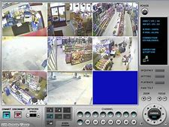
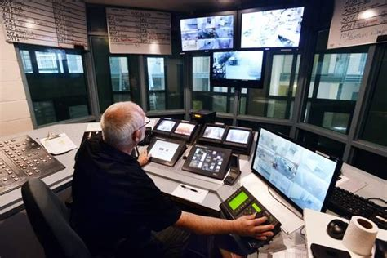
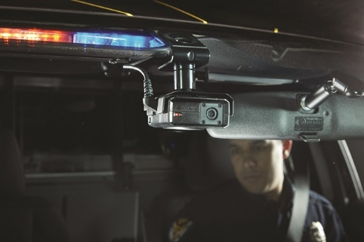
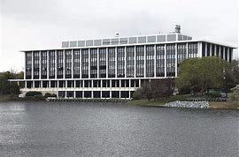
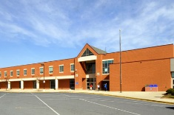
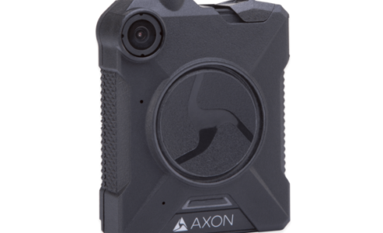
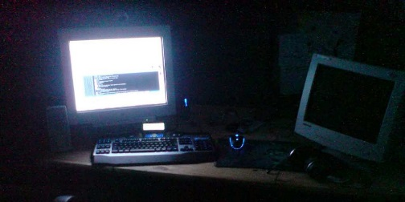
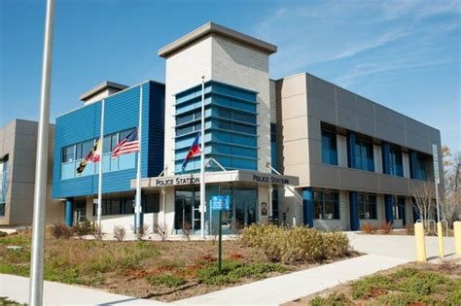
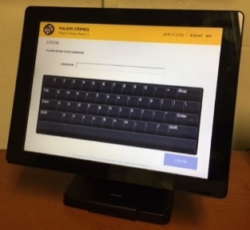
Video & Digital Evidence Used in the Investigation & Prosecution of Crimes
County Generated Shorter Retention
External Video and Images
County Generated Longer Retention
Notes:
County Generated with Shorter Retention Periods (unless identified as evidence).
Video Monitoring/Short term storage on camera drive (30 days) unless an incident is identified: School Buses, Ride-On, County Buildings, Schools
County Generated with Longer Retention Periods (regardless of whether identified as evidence).
Video is kept for longer period as it is more likely to become evidence. Not all video can be monitored live: MCPD Body-Worn Cameras, In Car Cameras, Interview Room Cameras, Investigative Surveillance Cameras. Corrections Cameras. MCSO Body-Worn Cameras. Also ECC Audio.
County Generated with Longer Retention Periods (regardless of whether identified as evidence).
Video is kept for longer period as it is more likely to become evidence. Not all video can be monitored live: MCPD Body-Worn Cameras, In Car Cameras, Interview Room Cameras, Investigative Surveillance Cameras. Corrections Cameras. MCSO Body-Worn Cameras. Also ECC Audio.
Camera systems are designed for specific purposes.
Different cameras require different video players.
Player can be saved with video in zip file.
We looked at different three general sources of video and digital evidence to better understand the various workflows, storage needs and where there might be opportunities to standardize some of our processes.
We have County generated video that is really about the use of security cameras and live monitoring of certain facilities. We finds these in county buildings, on county property and in school busses. We have a wide variety of cameras and multiple vendors. The camera choice is often driven by the specific business need. Retention Periods are generally 30 days unless an incident occurs and the video is requested by a law enforcement officer.
Next we have county generated video that is more specific to criminal justice and public safety. This includes our body worn cameras, dash cameras, interview room cameras and corrections cameras. We also put 911 center audio in this category. These all have longer starting retention periods regardless of whether the video is used in an investigation.
Finally, we have all of our external video and digital evidence. I would also include cell phone or tablet video taken by an officer and crime scene photos in this category in terms of how they might be managed. Virtually everything in this category is considered evidence as soon as it is obtained.

Slide 16
Vision of the Future Digital Evidence Management and Discovery Environment
Cloud Storage.
Video and Digital Evidence is shared via a single web portal using role based workflows.
eDiscovery Portal allows comprehensive discovery packet to be downloaded by defense counsel; eDiscovery log available to Court.
Security and Chain of Custody addressed with security permissions, workflows, audit logs and easily viewed and checked hash values.
Web portal and bandwidth enables access to digital evidence for viewing, live analysis and evidence prep with no discernable delays.
Evidence contained within a one of two types of case folders: 1) Ongoing Investigation 2) Case based on an incident number and subsequent charging documents.

Slide 17
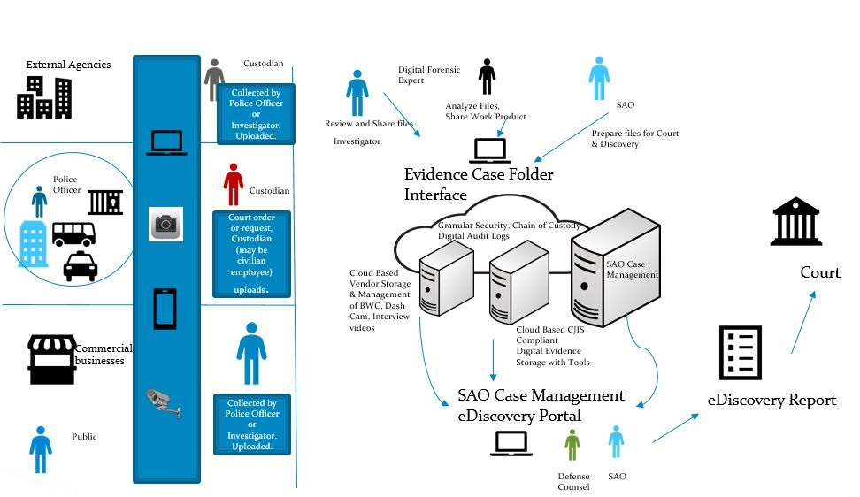
Digital and Evidence Management Vision of the Future
Notes:
Montgomery County places a high value on being able to provide an eDiscovery Portal and creating a single digital evidence log for court. We exploring whether we can do this through a system of pointers in the future rather than redundantly storing all data in our prosecutor case management system. We will explore whether content management or digital asset management systems can meet our needs but to date are unaware of systems designed on this scale for evidence.

Slide 18
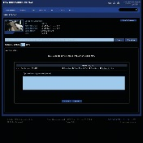
Business Requirements Video (To Be)
Police Officers or Investigators Obtain Video
Police Review Video for Relevant Sections and Share Video to State’s Attorney through a single website or portal
Requires determination of method to view video.
State’s Attorney can easily produce Discovery Log from single location of all digital evidence to include documents, digital files, photographs and video .
State’s Attorney Prepares Video for Discovery
1) Relevant Clip
2) Possible Redaction for Discovery or Court
State’s Attorney Shares Video with Defense Counsel through eDiscovery Portal.
MP2 Video Viewer
Intellex Player
REM Player
Verint Codec
VLC Media Player
Chain of Custody Preserved; Digital Log Produced.

Slide 19
Next Steps
Further Define Business and Technical Needs:
Convene Working Group
Develop projections to further define future needs.
Define Measurable Outcomes
Conduct a network analysis of current and planned capabilities to ensure viability of working with large files in the cloud and a complete technical analysis of current Prosecutor Case Management System to make upgrade or new acquisition decision.
Cost/benefit analysis of steps required to meet need.
Develop Strategic Plan. Components will include steps for requirements, acquisition and implementation of each of the following:
Data Architecture and Governance
Prosecutor Case Management System Upgrade/Acquisition Plan
System Architecture (Technology, Network, Security)
Notes:
Taking both tactical and strategic steps to support our existing systems and understand the viability of our vision in terms of cost and logistics. For example, our electronic crimes unit performs analysis on 500 GB files. In order to do this, they move the files to a local server. We have to understand whether it’s possible to increase bandwidth sufficiently to support some of the evidentiary work that needs to be done now and in the future. Cloud storage alone may not prove to be viable if network speeds can’t support the work.

Slide 20
Future Possibilities for Digital Evidence Integration
Craig D. Uchida, Ph.D., President Justice & Security Strategies, Inc.

Slide 21
Some Thoughts…
Digital evidence is everywhere and now affects almost all aspects of investigation and prosecution.
While much of the future of Digital Evidence Management (DEM) can be envisioned, some cannot.
The criminal justice community is not prepared for the digital evidence “tsunami” that is just off shore.
Technology will continue to grow exponentially and so will its ability to improve the management of digital evidence.
The funding and procurement of technology by the criminal justice community will be challenged to keep pace with this exponential growth.

Slide 22
SO HOW DO YOU TACKLE THIS CHALLENGE?
It’s time to re-evaluate digital evidence processes and workflows and prepare for the future.
Data “silos” and lack of data integration are the single largest roadblocks to effective DEM.
Technology can breakthrough “silos” and make data integration vastly more effective and efficient.
Why is this important?

Slide 23
DEM Tasks
Collection
Data Ingestion
Storage
Data Integration and Management
Access
Data Withdrawal
Use

Slide 24
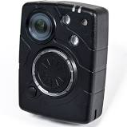
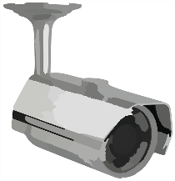
Single System Integration (SSI) Model

Slide 25
Single System Integration Model
CLOUD-BASED DEMS SINGULAR INTERFACE

Slide 26
Single System Integration Model
CLOUD-BASED DEMS INTEGRATION
Detectives
DA Investigators
Evidence Techs
Digital Forensics
Prosecutors
Administrators

Slide 27
Some SSI Factors For Consideration
Requires extensive collaborative operational and budgetary planning
Can be expensive
Takes time to become a reality
Commitment to a single system provider for all functions
May not provide the best individual solution for every function
Cloud based system provides certain major advantages
Ease of management and use

Slide 28
Federated System Integration (FSI) Model

Slide 29
Federated System Integration Model
RMS
Evidence Management
CAD & Dispatch
Crime Scene & Forensics
Prosecutor CMS
BWC Evidence Management
Investigative & Analytics
Public Portal

Slide 30
Federated System Integration Model
RMS
Evidence Management
CAD & Dispatch
Crime Scene & Forensics
BWC Evidence Management
Prosecutor CMS
Investigative & Analytics
Public Portal

Slide 31
Federated Systems Integration Model
RMS
CAD & Dispatch
Evidence Management
CLOUD-BASED DEMS INTEGRATION
BWC Evidence Management
Prosecutor CMS
Crime Scene & Forensics
Public Portal
Investigative & Analytics

Slide 32
Some FSI Factors for Consideration
Maintains existing systems, but allows for data integration
Requires extensive collaborative operational and budgetary planning
May cost less to implement
Can be made operational relatively quickly
Flexibility in DEM system provider
Allows for the individualized solution for each function

Slide 33
A Few Things a DEMS Should Do:
Integrate all relevant systems
Access and search all systems
Be easy to use with an intuitive interface
Provide content “packaging”
Embed real-time updates
Have a share capability
Have extensive auditing capabilities
Be adaptable and scalable
Apply content analytics
Have a robust administrative function
Provide conversion capabilities
Have extensive system security measures
Provide an effective cloud storage solution

Slide 34
Two Final Thoughts
Local criminal justice communities need to work together to develop a vision and model on which to guide future funding, procurement, and use of a DEMS.
Failure to do so will cost money and impact prosecutions.

Slide 35
Resources
BJA Body-Worn Camera Toolkit (https://www.bja.gov/bwc)
Getting started guide (https://www.bja.gov/bwc/topics-gettingstarted.html)
TTA website (www.bwctta.com)
Includes Webinars on BWC-CAD Integration & Digital Evidence Management http://bwctta.com/tta/webinars/
BWC subject matter experts
TTA email address (BWCTTA@cna.org)

Slide 36
Questions and answers
Please let us know your thoughts.

