Slide 1
Monitoring and Auditing for Compliance
James R. “Chip” Coldren, Jr., Ph.D., BWC TTA Project Director CNA
Janne Gaub, Ph.D., BWC TTA Subject Expert, East Carolina University
Matthew Segraves, Audit Manager, New Orleans, Louisiana, Police Department

Slide 2
Agenda
Introductions
Policy Monitoring Concepts & Considerations
National Overview
Considerations Regarding Discipline
Case Studies

Slide 3
The Critical Importance of Policy
Policy is an effective way to guide/control officer discretion
  Policy effectiveness – deadly force, less-lethal force, automobile and foot pursuits, K-9 deployments, domestic violence responses
Policy works IF:
  Policy is CLEAR (what is and what is not expected)
  Policy is KNOWN (training, widely available)
  Policy is ENFORCED (compliance monitored)

Slide 4
Phoenix SPI: Activation Compliance

Slide 5
Common Sense About Policy Compliance
Develop with committee or working group
Multiple formats, easily accessible
Measure understanding
Review and update
Train
Monitor
Encourage and enforce

Slide 6
National Trends
Many forms of auditing and compliance monitoring:
  Policy compliance
  Administrative compliance
  Performance review
Important questions to consider
  Who monitors? (Usually supervisors)
  How often do we monitor? (Continual/daily, weekly, monthly)
  How do we monitor? (By officer/unit/shift, random/purposeful, matching videos to calls)

Slide 7
Trends from PIP Grantees
Roughly 60% of FY16 and FY17 agencies specify how often
Majority of FY16 (76%) and FY17 (66%) agencies do not specify number of videos to be reviewed
About a quarter of FY16 (28%) and FY17 (25%) agencies require random selection of videos

Slide 8
Discipline Procedure
The Department is accountable for all official acts of its employees
  Holds officers to a high standard of conduct and discipline
Progressive discipline
Three perspectives
  Community/external stakeholders
  Department/internal
  Employee/fairness

Slide 9
Transforming Your Department
Through BWC Auditing

Slide 10
The Importance of BWC Auditing
Effective BWC audits can:
  Increase BWC activation
  Increase the chances you capture a critical incident
  Enable the department to conduct representative performance reviews through BWC footage
  Increase public trust through improved performance and transparency
Improper implementation of BWC can damage public trust

Slide 11
Levels of BWC Implementation
1. Policy & Discipline
2. BWC Utilization Audits
3. BWC Performance Audits

Slide 12
NOPD BWC Background
Widespread implementation in 2014
932 cameras today; ~1,225 officers
NOPD entered into a Consent Decree in 2013
BWCs are not required by Consent Decree
  Thoroughly incorporated into reforms
4 person audit unit conducts a variety of BWC audits

Slide 13
1st Level of Implementation
1. Policy & Discipline
2. BWC Utilization Audits
3. BWC Performance Audits

Slide 14
Policy & Discipline
Clearly define:
  When activation is required
  Consequences for failing to activate
Auditing needs to be tied directly to policy requirements.
NOPD policy:
  Activate BWC for all CFS and formal police actions
  Discipline: 3 strikes in a year before discipline
    Unless incident involves UOF, complaint, or injury
  NOPD policies available on www.nola.gov/nopd

Slide 15
2nd Level of Implementation
1. Policy & Discipline
2. BWC Utilization Audits
3. BWC Performance Audits

Slide 16
Original Auditing Method
Check to see whether a video exists for every required incident
Process:
  Randomly select a day
  Collect every officer activity report for that day
  Identify every interaction requiring BWC
  Assess whether BWC exists for every required interaction
  Calculate compliance score (next slide)
  Release Scorecard and audit data
  Take feedback and manage corrections
  Repeat every month

Slide 17
Calculating Compliance
Example:
  Activity report shows officer responded to 10 incidents requiring BWC
  Auditor only finds 9 videos
  9 videos for 10 incidents requiring videos = 90%
  Audit data looks like this:
Notes:
We like to give officers credit for what they got right. We could have given this officer a “No” for the day.

Slide 18
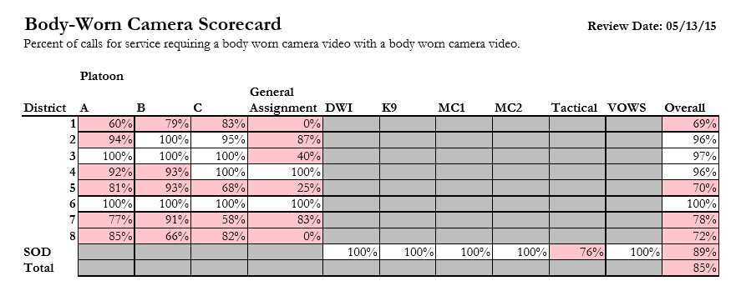
Early BWC Audit
Notes:
Why did we start with BWC? Interest to Judge, Consent Decree, and BWC do change the game in many ways.
What did we do? Took every hand-written activity log each officer filled out for a day, and manually checked to see if there was a video for every item that is required by policy. We had to find out how were we performing on this critical indicator – and wanted to provide not only an overall result, but at a detailed enough level for supervisors to take action.

Slide 19
A Few Months Later
Notes:
Why did we start with BWC? Interest to Judge, Consent Decree, and BWC do change the game in many ways.
What did we do? Took every hand-written activity log each officer filled out for a day, and manually checked to see if there was a video for every item that is required by policy. We had to find out how were we performing on this critical indicator – and wanted to provide not only an overall result, but at a detailed enough level for supervisors to take action.
Within 6 months, performance across the board went from 85% to 99% and has sustained at that level since – providing us with proof that we had developed a mechanism to measure performance, and provide it back in a meaningful way to drive change.

Slide 20
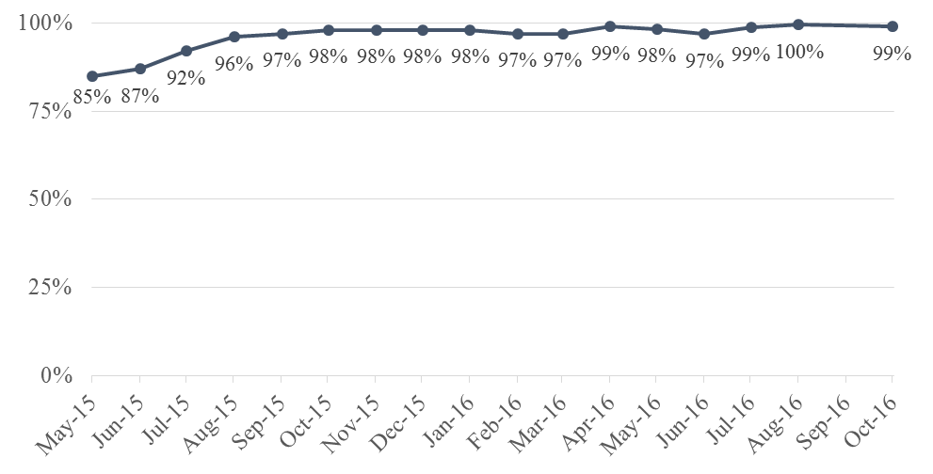
BWC Compliance Over Time
Notes:
Why did we start with BWC? Interest to Judge, Consent Decree, and BWC do change the game in many ways.
What did we do? Took every hand-written activity log each officer filled out for a day, and manually checked to see if there was a video for every item that is required by policy. We had to find out how were we performing on this critical indicator – and wanted to provide not only an overall result, but at a detailed enough level for supervisors to take action.
Within 6 months, performance across the board went from 85% to 99% and has sustained at that level since – providing us with proof that we had developed a mechanism to measure performance, and provide it back in a meaningful way to drive change.

Slide 21
3rd Level of Implementation
1. Policy & Discipline
2. BWC Utilization Audits
3. BWC Performance Audits

Slide 22
BWC Complete
Once NOPD routinely achieved ~98% compliance with activating cameras, we began to assess whether BWC videos were complete.
  Higher standard of compliance, but also more time intensive
  Integrated the “BWC Complete” audits with other performance reviews of force, stops, procedural justice, etc.

Slide 23
BWC Performance Audits
Once you are using BWCs reliably as evidenced by your BWC utilization audits, you can conduct representative performance reviews.
NOPD uses a four person audit unit to conduct a wide variety of audits on a frequent basis.
  Systematic supervisory reviews can serve a similar purpose.

Slide 24
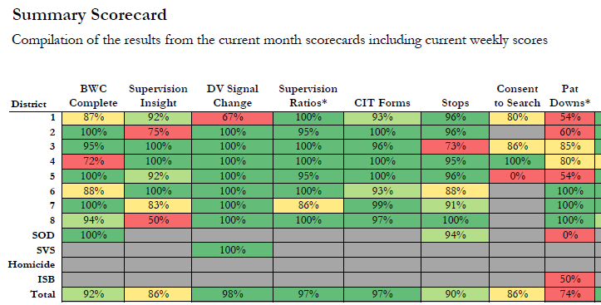
BWC Performance Audits
Notes:
Frequency; clarity of visuals; reinforced in weekly meetings

Slide 25
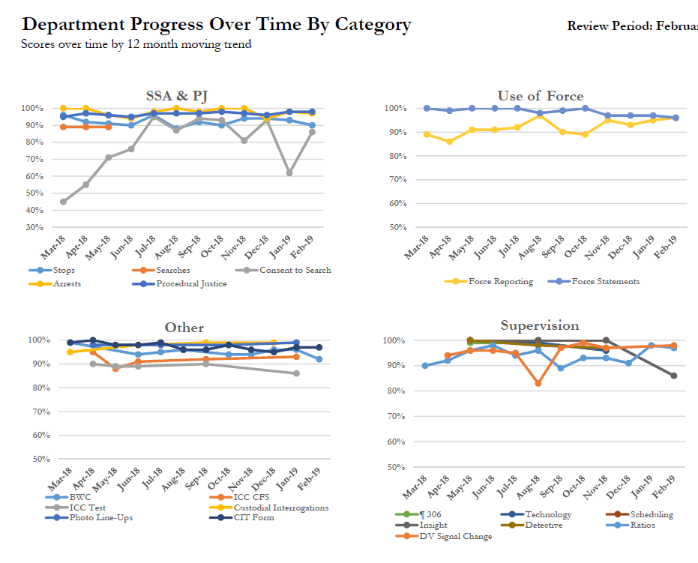
BWC Performance Audits
Notes:
Frequency; clarity of visuals; reinforced in weekly meetings

Slide 26
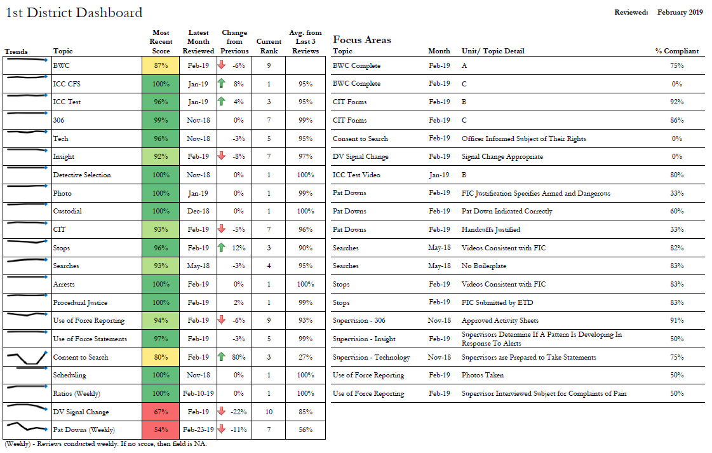
BWC Performance Audits
Notes:
Frequency; clarity of visuals; reinforced in weekly meetings

Slide 27
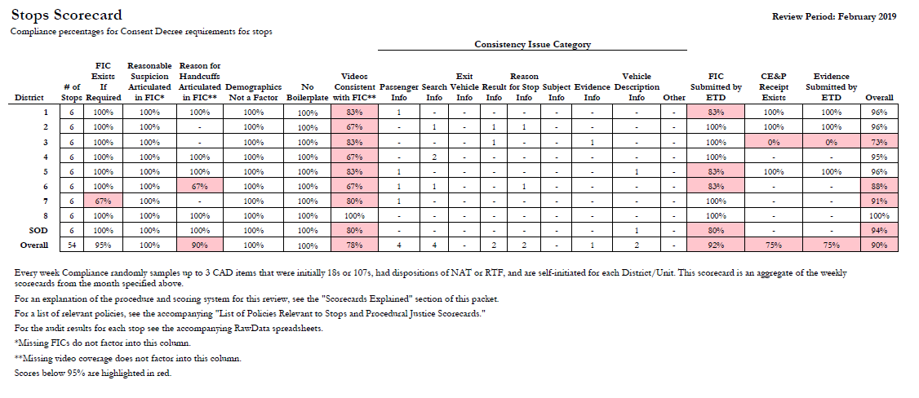
BWC Performance Audits
Notes:
Frequency; clarity of visuals; reinforced in weekly meetings

Slide 28
Improving through BWC Audits

Slide 29
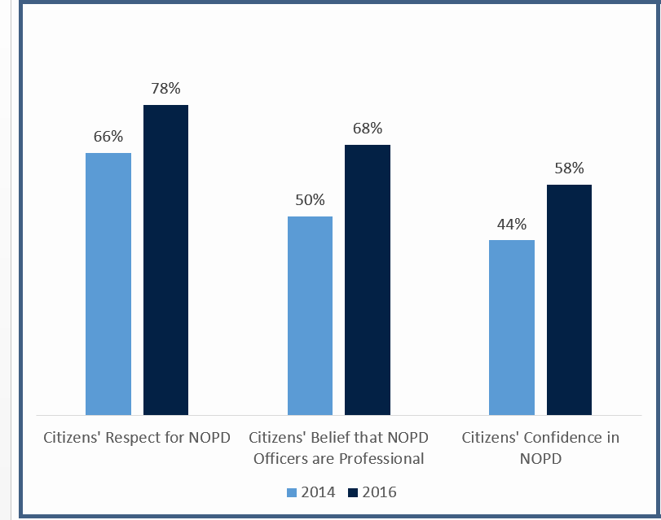
Increase in Public Trust & Satisfaction

Slide 30
Better Interactions with the Public

Slide 31
Decrease in Public Complaints

Slide 32
Decrease in Serious Force

Slide 33
Lessons Learned

Slide 34
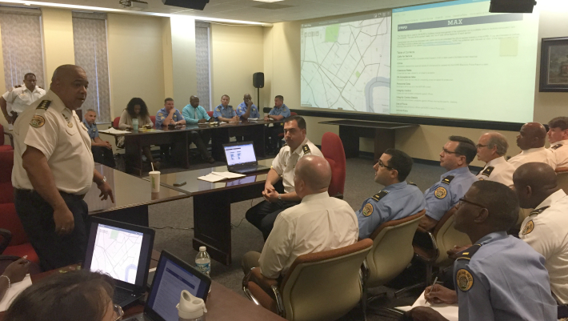
Keys to Data-Driven Management
Buy-in from the top

Slide 35
Keys to Data-Driven Management
Buy-in from the top
Defining change and performance standards
  Clarity is critical; can’t just say “do better”
  Share your audit data
  Meet with auditees to explain data
  Create guides that explain the audit process

Slide 36
Keys to Data-Driven Management
Buy-in from the top
Defining change and performance standards
  Clarity is critical; can’t just say “do better”
  Share your audit data
  Meet with auditees to explain data
  Create guides that explain the audit process
Frequently assess performance
  Tighter feedback loop → quicker change
  Strive for weekly or monthly
  Reduce frequency when compliance is consistently high

Slide 37
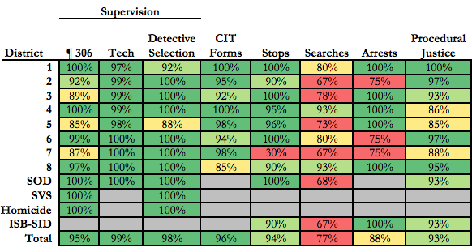
Keys to Data-Driven Management
Clearly visualize performance measurements

Slide 38
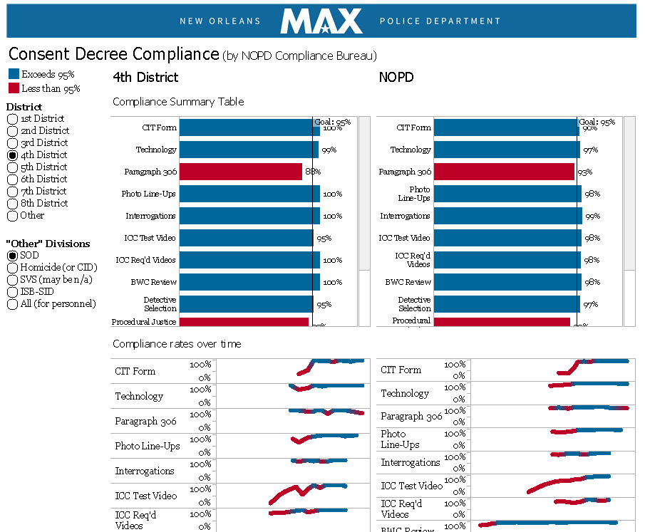

Keys to Data-Driven Management
Frame management meetings around data
Crime
Consent Decree Compliance
Calls for Service
Use of Force
Clearance Rates
Response Times
DA Acceptance Rates
Complaints

Slide 39
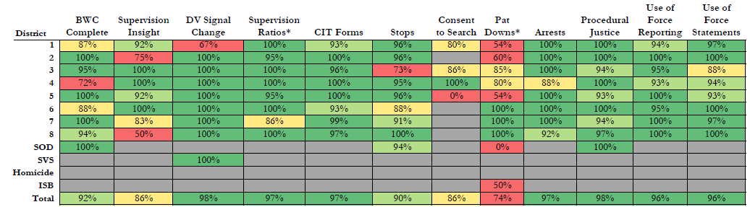
Keys to Data-Driven Management
Embed BWCs within a broader culture of accountability
USE OF FORCE REVIEW BOARD

Slide 40
Holistic BWC Implementation
1. Policy & Discipline
2. BWC Utilization Audits
3. BWC Performance Audits

Slide 41
Transformative Impact
Start where you can and build from there.
Where we started
“Worst police department in the country”
– Former DOJ attorney
Where we are
“Astounding” transformation
“A completely different department”
– DOJ
Notes:
Where we started: “one of the most troubled departments in the country” - DOJ
Former DOJ attorney: “The worst police department in the country.”

Slide 42


Where to Find More
Police Quarterly: “Police Reform Through Data Driven Management”
Find and Open Data at: NOPDnews.com
Matt Segraves
Compliance Manager
Compliance Bureau
mhsegraves@nola.gov

