Slide 1
Working with Prosecutors and the Evidentiary Value of BWCs
Damon Mosler, BWC TTA Lead and Deputy District Attorney, San Diego County
Roger Nunez, BWC TTA Lead and Sergeant, Los Angeles, CA Police Department
This material was supported by Grant No. 2015-DE-BX-K002 awarded by the Bureau of Justice Assistance (BJA). BJA is a component of the U.S. Department of Justice Office of Justice Programs. Points of view or opinions contained herein do not necessarily represent the official position or policies of the U.S. Department of Justice.

Slide 2
Prosecution Side: Numbers
2015 – 75,000 videos (35,000 + 40,000) – 40% phased
15,000 hours
12 TB
2017 – 160,000 videos – (60-80% deployment
40,000 hours
65TB
2018 – 11 TB a month!!
From 3,400 cops with BWCs-
San Diego County – 3.2 million population ~ 4,000 sq. miles

Slide 3
Goal
Management of videos without creating delays in our cases

Slide 4
Timeliness/Questions for Law Enforcement
When will law enforcement get videos to prosecutors?
Can they/you meet court imposed timelines?
Which videos are critical for issuing?
Understand workflow – both sides

Slide 6
All Video – All Agencies
Labeling – retention – tracking videos down
BWC SEARCH REQUEST
Case Name People v. xxx
Case Number SDPD Incident #16xxx
Date of Incident 5/29/16
Time of Incident Approximately 12:47 p.m.
Officers name | ID number | Have BWC | Need searched
1)Kitchen | # | ☐ | ☒
2)Junker | # | ☐ | ☒
3) |  | ☐ | ☐
4) |  | ☐ | ☐
5) |  | ☐ | ☐
6) |  | ☐ | ☐
7) |  | ☐ | ☐

Slide 7
Discovery – In General
Must the case prosecutor review BWC video before discover to defense to identify and redact non-discoverable, privileged information?
Can they?

Slide 8
Redaction – Safety and the Law
Personal Identifying Information
Internal passwords and other sensitive information
CI – Material

Slide 9
Pro Per Defendants*
In Custody-
Out of Custody
Protective Orders/motions/process – for all defense counsel.
*- Defendants who are representing themselves.

Slide 10
Trust – DA as IA?
Policy for reporting poor behavior while keeping trust with law enforcement
Its only for official use – to do so otherwise=violation

Slide 11
Court Aspects
How San Diego obtained defense buy-in

Slide 12
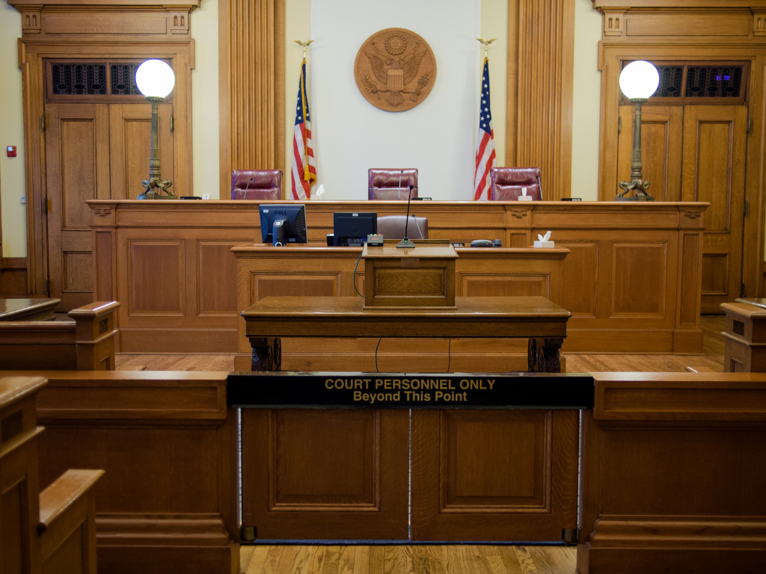

Slide 14
Impact 1 – Emotion
Report may underplay incident –
“We walked to the rear with the boyfriend and could hear girlfriend crying. After checking on her we went back and cleared her unit to make sure there was not a suspect inside.”

Slide 15
Impact 1 – Benefit
The true emotion of the victim
The true credibility of the witnesses

Slide 16
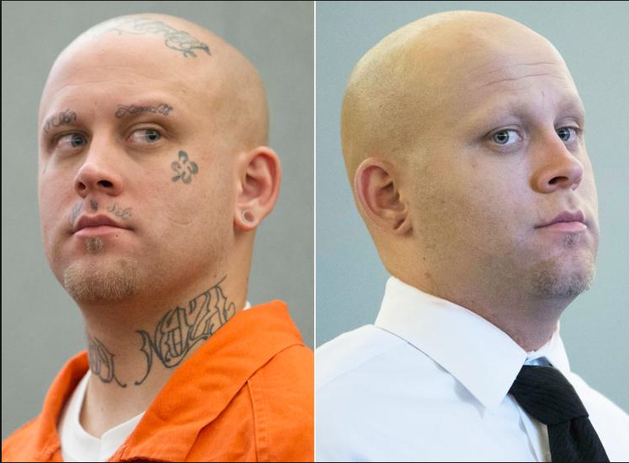
Impact 2 – True View of Defendant

Slide 17
Impact 2 – Benefit
Seeing defendant with law enforcement
Defendant not cleaned up
Its an authentic view of the defendant - in his or her environment

Slide 18
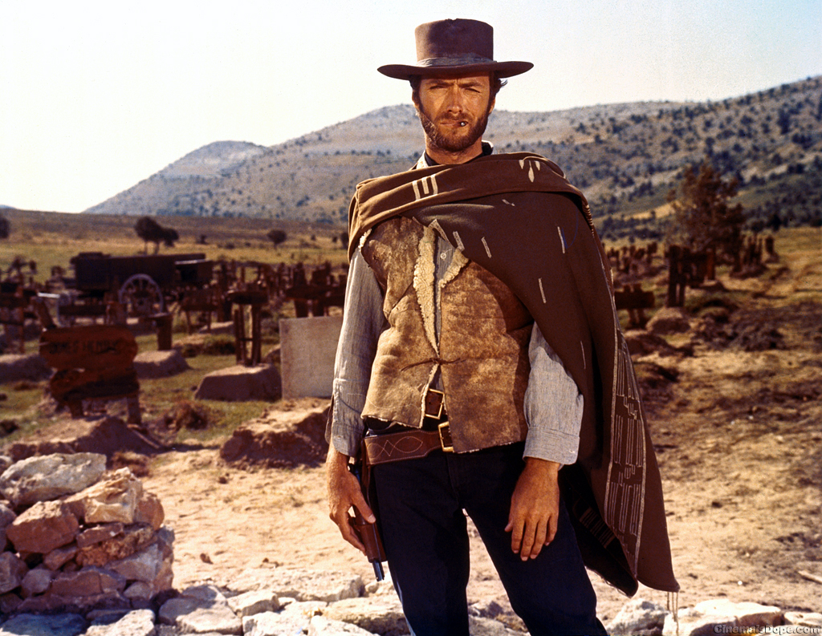

Slide 19
Impact 3 – Force or Grit
On any hands-on-officer case – need to see all angles to understand what happened
Life on the streets – how to prepare jury for colorful or cringe worthy events

Slide 20
Caution
How to convey that the video is not the entire picture or that at times, policing is not pretty

Slide 21
Impact 4 – Setting the Scene
During trial prep, explain how the videos can be of value
With proper training, officers can do several different types of things with the video
Encourage this type of use with officers

Slide 22
Trial Impact – Pre-Trial Prep
BWCs- Understand the equipment and how it works
Malfunctions?
Off-camera events

Slide 23
Unforeseen Trial Impact
Report variations – possible impeachment
How to handle in court – anticipate and prepare (overtime for trial prep?)
Over-reliance on video by law enforcement and/or Deputy District Attorney – still need good police work

Slide 24
Understanding Video Limitations
Cannot replace a thorough investigation
BWCs may capture more information than an eye sees or a person perceives
Body may block the view
One camera angle may not be enough
Speed and depth are different
A camera encourages second-guessing

Slide 25
Training – Improve Videos
Get the prosecutor’s perspective regarding the use of BWCs
Prosecutors can help with narration for consent searches, reasons for terminating a recording, and how to record the execution of a search warrant
Avoid the need for redaction (Driver License or other identifying information)

Slide 26
Coordination – Prosecution or Law Enforcement
Offer to coordinate with all law enforcement agencies in your jurisdiction so that policies are as uniform as possible for better integration by your agency or prosecutor
For example, you could offer to host a quarterly meeting with command staff and training officers to share BWC “best practices”

Slide 27
Managing Expectations
Voire Dire
Direct Examination
Find Video to Play
Argument

Slide 28
Questions?

