Slide 1
Body-Worn Camera Policy Issues and Trends
Dr. Michael White, BWC TTA Co-Director & Professor,
Arizona State University
Dr. Charles Katz, Professor, Arizona State University

Slide 2
Overview
Part I: Body-Worn Camera (BWC) Policy
The Importance of Policy
BJA BWC Policy and Implementation Program (PIP)
Policy review process and Policy Review Scorecard
Part II: Policy Analysis of Year 1-2 Grant Awardees
Current focus on four selected operational areas of PIP sites
Key Issues and Trends
Part III: BWC Policy Resources
Final questions and/or comments

Slide 3
The Importance of Policy

Slide 4
Why is Policy Important?
FACT: 4 decades of research demonstrate policy as an effective way to guide/control officer discretion
Policy effectiveness – deadly force, less-lethal force, automobile and foot pursuits, K-9 deployments, domestic violence responses
Policy works IF:
Policy is CLEAR (what is and what is not expected)
Policy is KNOWN (training, widely available)
Policy is ENFORCED (compliance monitored)

Slide 5
Why is Policy Important?
Administrative Policy Proponents:
IACP, ABA, US DOJ (Civil Rights), ACLU, PERF, and so on.
Commission on Accreditation of Law Enforcement Agencies (CALEA)
“CALEA Accreditation requires an agency to develop a comprehensive, well thought out, uniform set of written directives. This is one of the most successful methods for reaching administrative and operational goals, while also providing direction to personnel.”

Slide 6
Why is BWC Policy Important?
Communicates goals of the BWC program
Conveys expectations to officers
Allows for internal and external collaboration
Allows for internal and external transparency
Guides officer decision-making and behavior
Provides a foundation for accountability
Do officers follow policy?
What to do if they don’t?

Slide 7
BWC Policy and Officer Accountability
BWCs hold great promise:
Greater transparency
Enhanced legitimacy
Reduced citizen complaints and use of force
Civilizing effect
Evidentiary value
The benefits of BWCs are short-circuited by officer noncompliance with policy
Very few studies of officer compliance with BWC policy
Hedberg et al. (2016) – Phoenix PD
Ariel et al. (2016) – 10 agencies (UK and US)

Slide 8
Phoenix SPI: Activation Compliance

Slide 9
Studies of BWC Policy Compliance
Hedberg et al. (2016: 16)
“if BWCs are employed as prescribed [i.e., 100 percent activation compliance], a majority of complaints against officers would be eliminated”
Ariel et al. (2016)
Officers followed policy (activation and citizen advisement)
use of force declined by 37%
Officers did not follow policy
use of force increased by 71%

Slide 10
Activation Compliance, New Orleans PD, May 2015 through October 2016

Slide 11
BJA BWC Policy and Implementation Program (PIP)

Slide 12
BJA BWC Policy and Implementation Program (PIP)
2015: 73 awards totaling $19.3 Million
2016: 106 awards totaling $16.9 million
2017: 80+ awards totaling ~$14 million
Training and Technical Assistance (TTA) Team
Wide range of support services
Administrative policy review
BWC TTA website (http://www.bwctta.com/)

Slide 13
Policy Review Process
Grantees can access 10% of funds immediately upon reward
To access remaining funds, grantee submits their BWC policy to the TTA team and assurances are made that the policy development process was comprehensive and deliberate.
TTA team reviews the policy with the Policy Review Scorecard framework
Assessment of policy considerations against core 41 elements
TTA team works with grantee to modify policy (as needed)

Slide 14
Overview of Scorecard and Review Process
Eleven areas of BWC policy covering 41 specific issues
Mandatory issues must be covered in policy to pass (n=17)
Score of 80% or better total (17/17 for mandatory issues)
Comprehensiveness only, not prescriptive nor directional

Slide 15
Scorecard Policy Areas
Policy Development
General Issues
Video Capture – Activation
Video Capture – Deactivation
Data Transfer/Download
Data Storage/Retention
BWC Viewing
BWC Training
Public Release
Policy and Program Evaluation
BWCs and Use of Force

Slide 16
Policy Analysis of Year 1-2 PIP Sites

Slide 17
The Policy Analysis- 129 PIP agencies
FY 15 -54 agencies (red)
FY 16 -75 agencies (blue)

Slide 18
Selected Policy Analysis Findings
BWC Activation and Deactivation
Citizen Notification
Officer Authority to Review
Supervisor Authority to Review
http://bwctta.com/resources/bwc-resources/key-trends-body-worn-camera-policies

Slide 19
Activation of the BWC: 3 Approaches
1. Mandatory
Officers will activate the BWC to record all contacts with citizens in the performance of calls for service in which official contact is made with citizens.
2. Restriction
The BWC should not be used when interacting with known confidential informants or undercover officers.
3. Discretion or ‘with conditions’
The BWC may also be activated whenever the deputy feels its use would be beneficial to his/her sheriff’s office duties.

Slide 20
BWC Policy Trends on Activation
1. All law enforcement agencies mandate and/or prohibit activation for certain types of encounters.
No agency allows full officer discretion on BWC activation.
2. Most law enforcement agencies (60%) allow for discretionary activation under certain circumstances.
The most common circumstances are situations dealing with crime victims or witnesses.
*Consistency between FY 15 and FY 16 sites

Slide 21
Citizen Notification of the BWC
1. Mandatory
Member shall inform all individuals identifiably present as soon as reasonably practical, that their oral/video communications will be or have been intercepted and recorded
2. Recommended
It is recommended that Officers inform subjects when they are being recorded, unless doing so would be unsafe, impractical, or impossible
3. Not Required
Officers are not required to advise citizens they are being recorded

Slide 22
BWC Policy Trends on Citizen Notification
1. Most agencies do NOT mandate citizen notification.
FY 15- 22%
FY 16- 13%
2. 40% recommend notification but do not require it.
3. The rest state that officers are not required to notify citizens of the BWC.
FY 15- 37%
FY 16- 45%
*Mandatory notification is less common in FY 16 sites

Slide 23
Officer Authority to Review
1. Routine Review
Department personnel can view their own captured video while on duty to refresh their memory prior to completion of incident reports or preparing for court proceedings.
2. Post-Critical Incident/Internal Investigation Review
Upon advisement that the officer is the subject of (or witness to) an internal or criminal investigation or complaint, the officer can no longer view the BWC video of the event in question unless expressly authorized by Internal Affairs or the Shift Lieutenant or designee if the investigation or inquiry is being conducted in the chain of command.

Slide 24
BWC Policy Trends on Officer Review
1. Nearly all agencies allow officer review for report writing.
FY 15- 95%
FY 16- 98%
2. Less than 1/3 allow officers unrestricted access to BWC footage during an investigation.
FY 15- 31%
FY 16- 23%
3. Critical Incident: Less than 10% require officer to give a statement first BEFORE viewing BWC.
FY 15- 5%
FY 16- 9%
*Officer authority/access is more restricted in FY 16 sites

Slide 25
Supervisor Authority to Review
1. Administrative Review
A supervisor may review specific BWC media or data for the purpose of training, civil claims, and administrative inquiry.
2. Compliance Review
Monthly, supervisors will randomly review 10 recordings pertaining to his/her area of responsibility to ensure that the equipment is operating properly and that officers are using the cameras appropriately and in accordance with this policy and training.
3. Performance Review
Supervisors will conduct random weekly reviews of selected recordings in order to assess deputy performance as well as to identify videos that may be appropriate for training.

Slide 26
BWC Policy Trends on Supervisor Review
1. Nearly all agencies allow supervisor review for administrative purposes.
FY 15- 94%
FY 16- 99%
2. Most agencies allow supervisor review for policy compliance.
FY 15- 50%
FY 16- 93%
3. Most agencies allow supervisor review for officer performance.
FY 15- 66%
FY 16- 93%
*Supervisor authority/access is greater in FY 16 sites.

Slide 27
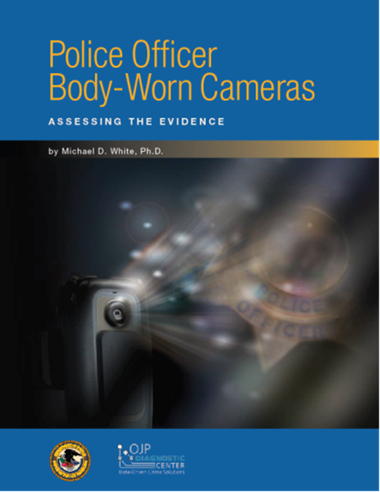
PERF/COPS and “Assessing the Evidence” Reports

Slide 28
BJA National Body-Worn Camera Toolkit
February 26-27, 2015: Two-day expert panel at the White House
May 2015: Toolkit “goes live” at: https://www.bja.gov/bwc
Serves as an information warehouse on BWCs
FAQ format in the areas of:
Research
Policy
Technology
Privacy
Training
Stakeholders
Law Enforcement Implementation Checklist

Slide 29
BJA National Body-Worn Camera Toolkit

Slide 30
Toolkit Podcast Series

Slide 31
Toolkit: Policy Resources

Slide 33
Other Policy-Related Resources
Model Policies: IACP, ACLU
National Institute of Justice (NIJ) Market Survey

Slide 34
THANKS!
Questions?
Comments?

