Slide 1
Body Worn Camera National Meeting 2019
BUREAU OF JUSTICE ASSISTANCE

Slide 2
Procurement Considerations
Stephen Fender
Bureau of Justice Assistance (BJA)

Slide 3
Federal Guidelines For BWC Procurement
Ensure competition for all federal funds
All procurement transactions must be conducted in a manner to provide to the maximum extent practical, open and free competition.
Grantees should follow their local/state guidelines for procurement
When deciding the specific processes for bids, timelines, and the scope of those documents, you should use your local/state guidelines.
Timeline
Agency timeline is not a factor for compliance.

Slide 4
Avoid Unnecessary Restrictions on Competition
Unreasonable requirements in order to qualify for competition;
Unnecessary experience or excessive bonding;
Engaging in noncompetitive practices between firms or in noncompetitive contracts with consultants on retainer;
Staff conflicts of interest (stock ownership);
Specifying a “brand name” product without provision for an equivalent product to be offered (and without performance requirements or features being clearly described); or
Any arbitrary action in the procurement process.

Slide 5
Procurement Thresholds
Small purchase procedures are those relatively simple and informal procurement methods for securing services, supplies, or other property that do not cost more than the simplified acquisition threshold (currently set at $250,000).
For purchases above the threshold Competitive Sealed Bidding is recognized as the preferred method of procurement.
Micro purchase threshold is now $10,000.
The non-federal entity should consider the most economical approach to the acquisition.

Slide 6
Sole Source
Exceptions to the prime rule of competition. These exceptions result in “sole source” or non competitive contracting.
The administrative rules are quite clear regarding the necessity to have open and free competition to satisfy grantee contractual requirements.
Grantees may make the initial determination that competition is not feasible if one of the following circumstances exists:
The item of service is available only from a single source.
The public exigency or emergency for the requirement will not permit a delay resulting from a competitive solicitation.
After solicitation of a number of sources, competition is considered inadequate.
Non-competitive proposals that exceed the Simplified Acquisition Threshold of $250,000 must be approved by BJA.

Slide 7
Procurement Documentation
Monitoring documentation
It is crucial that you maintain all procurement related documentation for BJA review.
Regardless of the need for approval, all procurement decisions should be documented and evidence maintained for review.
What was sent out, what was received, how the decision was made.
Match Requirements
Treated as the same as federal funds
All documentation should be maintained
Federal procurement rules apply

Slide 8
Technology Procurement Resources
What is out there to help me define my requirements?
BWC Toolkit
BWC Podcast Series
NIJ 2016 Market Survey and Primer
BWC TTA
BWC Generic RFP
IACP Body Worn Camera Model Policy
IACP Technology Policy Framework

Slide 9
Testing and Evaluation
Given the complex nature of law enforcement technology, it is not uncommon to test products before a purchase is made.
Testing and evaluation are not equal to procurement.
Testing and evaluation are often conducted using select vendor products.
Testing and evaluation may inform the final procurement documents by serving as the foundation for procurement criteria.
Test them like you’ll plan to use them! Range, driving, DTs, etc.

Slide 10
Technology Considerations
Camera Technology
Camera Mounting Location (Chest, Head or Glasses, Shoulder or Collar)
Recording (Format, Resolution, Frame Rate/Speed FOV, Lux Rating, Audio, Pre-Event Buffer)
Storage Onboard & Transfer Method (Dock, Cellular, Encryption & Encoding)
Camera Field of View and Focus
Battery Life, runtime and standby
Add-on Features (Facial Recognition, Live Stream, Bluetooth, GPS, etc.)
Storage Options: Server versus Cloud
Digital Media Evidence Management
Audit Trail and Access Control
Video Analytics
Redaction
Price

Slide 11
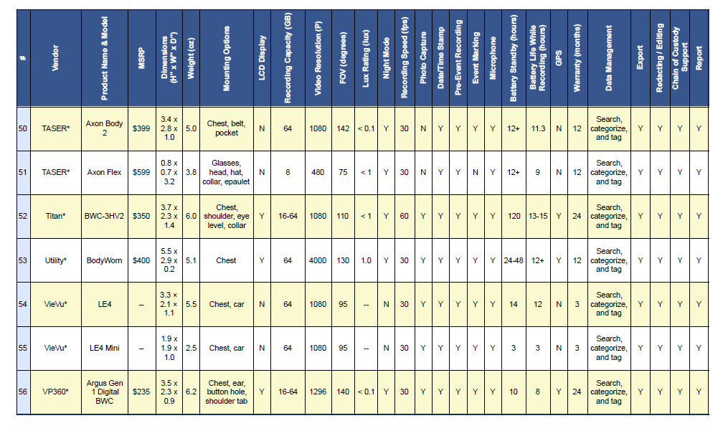
A few of the cameras and systems from RT&E Center Report
Source: Market Survey of Body Worn Camera Technologies (National Institute of Justice, 2016)
Notes:
From 2016 Market Survey. Available on disk in Excel at break.

Slide 12
Storage Considerations Cloud, Server and Hybrid
Security, Encryption, Auditing Capability, & Connectivity
Data Access, Control and Sharing & Ownership
Capacity and Growth
System responsibility for maintenance or failure
Redundancy
Retention
Cost

Slide 13
Storage Considerations
Cloud | Local storage
+ Limitless data storage | + Security under agency control
+ Easily expandable | - Require purchase of hardware
- Expensive fees | - Require in-house IT expertise
- Relying on Cloud vendor for security
Primary advantages of local storage include control and data ownership
Primary advantages of cloud storage include managing demand & infrastructure growth and offloading in-house labor costs

Slide 14
Cost Considerations
Cloud vs Local Storage Costs Are Hard to Compare
Vendors and Service Providers May Be Unwilling to Breakout Costs Clearly
Data Retention Laws & Policies May Affect Choices
Trade-Offs in Labor Costs, Analytics Options, Processing Speed, Space Requirements and Infrastructure Upgrades
Cost Consideration | Description
Acquisition | Initial purchase of the BWCs
Installation | Cost to install the software, hardware, and server (if needed)
User Training | Cost to provide training and periodic refresher trainings
Maintenance | Data storage of audio/video footage on local server or via cloud
Consumables/Accessories | Cost for batteries and/or additional accessories needed for mounting
Energy and Energy Dependence | Cost for additional energy expenditure due to BWC use
Software Licenses | Cost to obtain and renew the software license
Operations and Labor | Daily cost for operations and labor of using the BWC

Slide 15
Cost Calculator

Slide 16
Guidance for Purchasing BWCs
“Generic” Request for Proposals (RFP) - Based on existing RFPs from other agencies
http://bwctta.com/sites/default/files/BWC%20TTA%20Generic%20RFP%20FINAL.pdf
Template/Model to assist agencies during the procurement process
Disclaimer – not definitive; does not replace Federal, state or local requirement

Slide 17
Questions and Answers

Slide 18
Resources
BJA Body-Worn Camera Toolkit
https://www.bja.gov/bwc/topics-gettingstarted.html
BJA BWC Podcast Series on iTunes
https://itunes.apple.com/us/podcast/bja-bwc-podcast-series/id1052357304?mt=2
Body-Worn Camera Training and Technical Assistance
http://www.bwctta.com/
Generic Request for Proposals (RFP)
http://bwctta.com/resources/bwc-resources/generic-request-proposals-rfp
2015 DOJ Financial Guide
http://ojp.gov/financialguide/DOJ/pdfs/2015_DOJ_FinancialGuide.pdf
Federal Procurement Guide
http://ojp.gov/financialguide/PDFs/New%20Procurement%20Guide_508compliant.pdf

Slide 19
Bureau of Justice Assistance Office of Justice Programs U.S. Department of Justice
Contact: Stephen Fender
Division Chief
810 Seventh Street NW.
Washington, DC 20531
Tel: 202-532-0027
stephen.fender@usdoj.gov

Slide 20
Notes on Competitive Sealed Bidding
Used when the following conditions exist:
1. The requirement can be described and is finite and specific in detail. The contract will be awarded to the lowest responsive (the bid meets all the requirements of the solicitation including design specifications), and responsible bidder (the contractor has the capability in all respects) that can accomplish the contract requirements.
2. There are two or more contractors that could satisfy the requirement and are willing and able to compete for the contract.
3. There is enough time available to issue the solicitation, conduct a public bid opening, and award a firm fixed-price contract to the lowest responsive and responsible bidder.
4. The requirement to hold “negotiations/discussions” is not necessary and does not exist
Notes:
Notes if needed.

