Slide 1
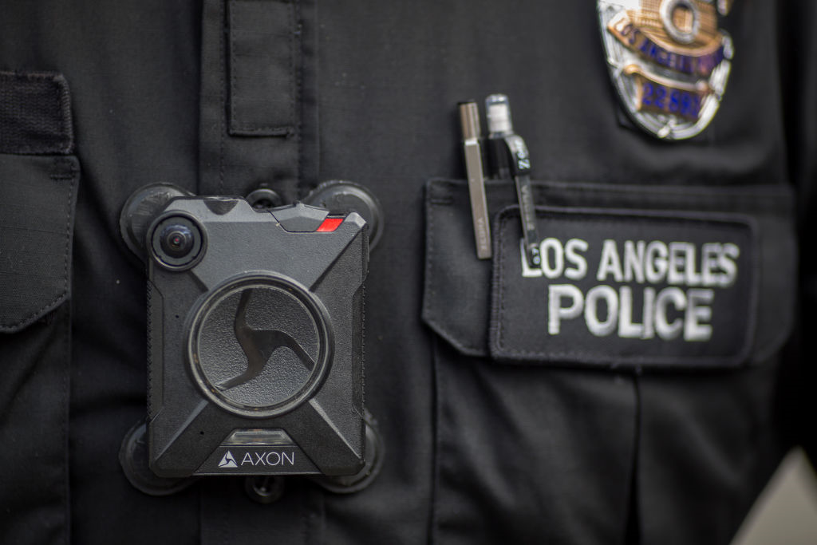
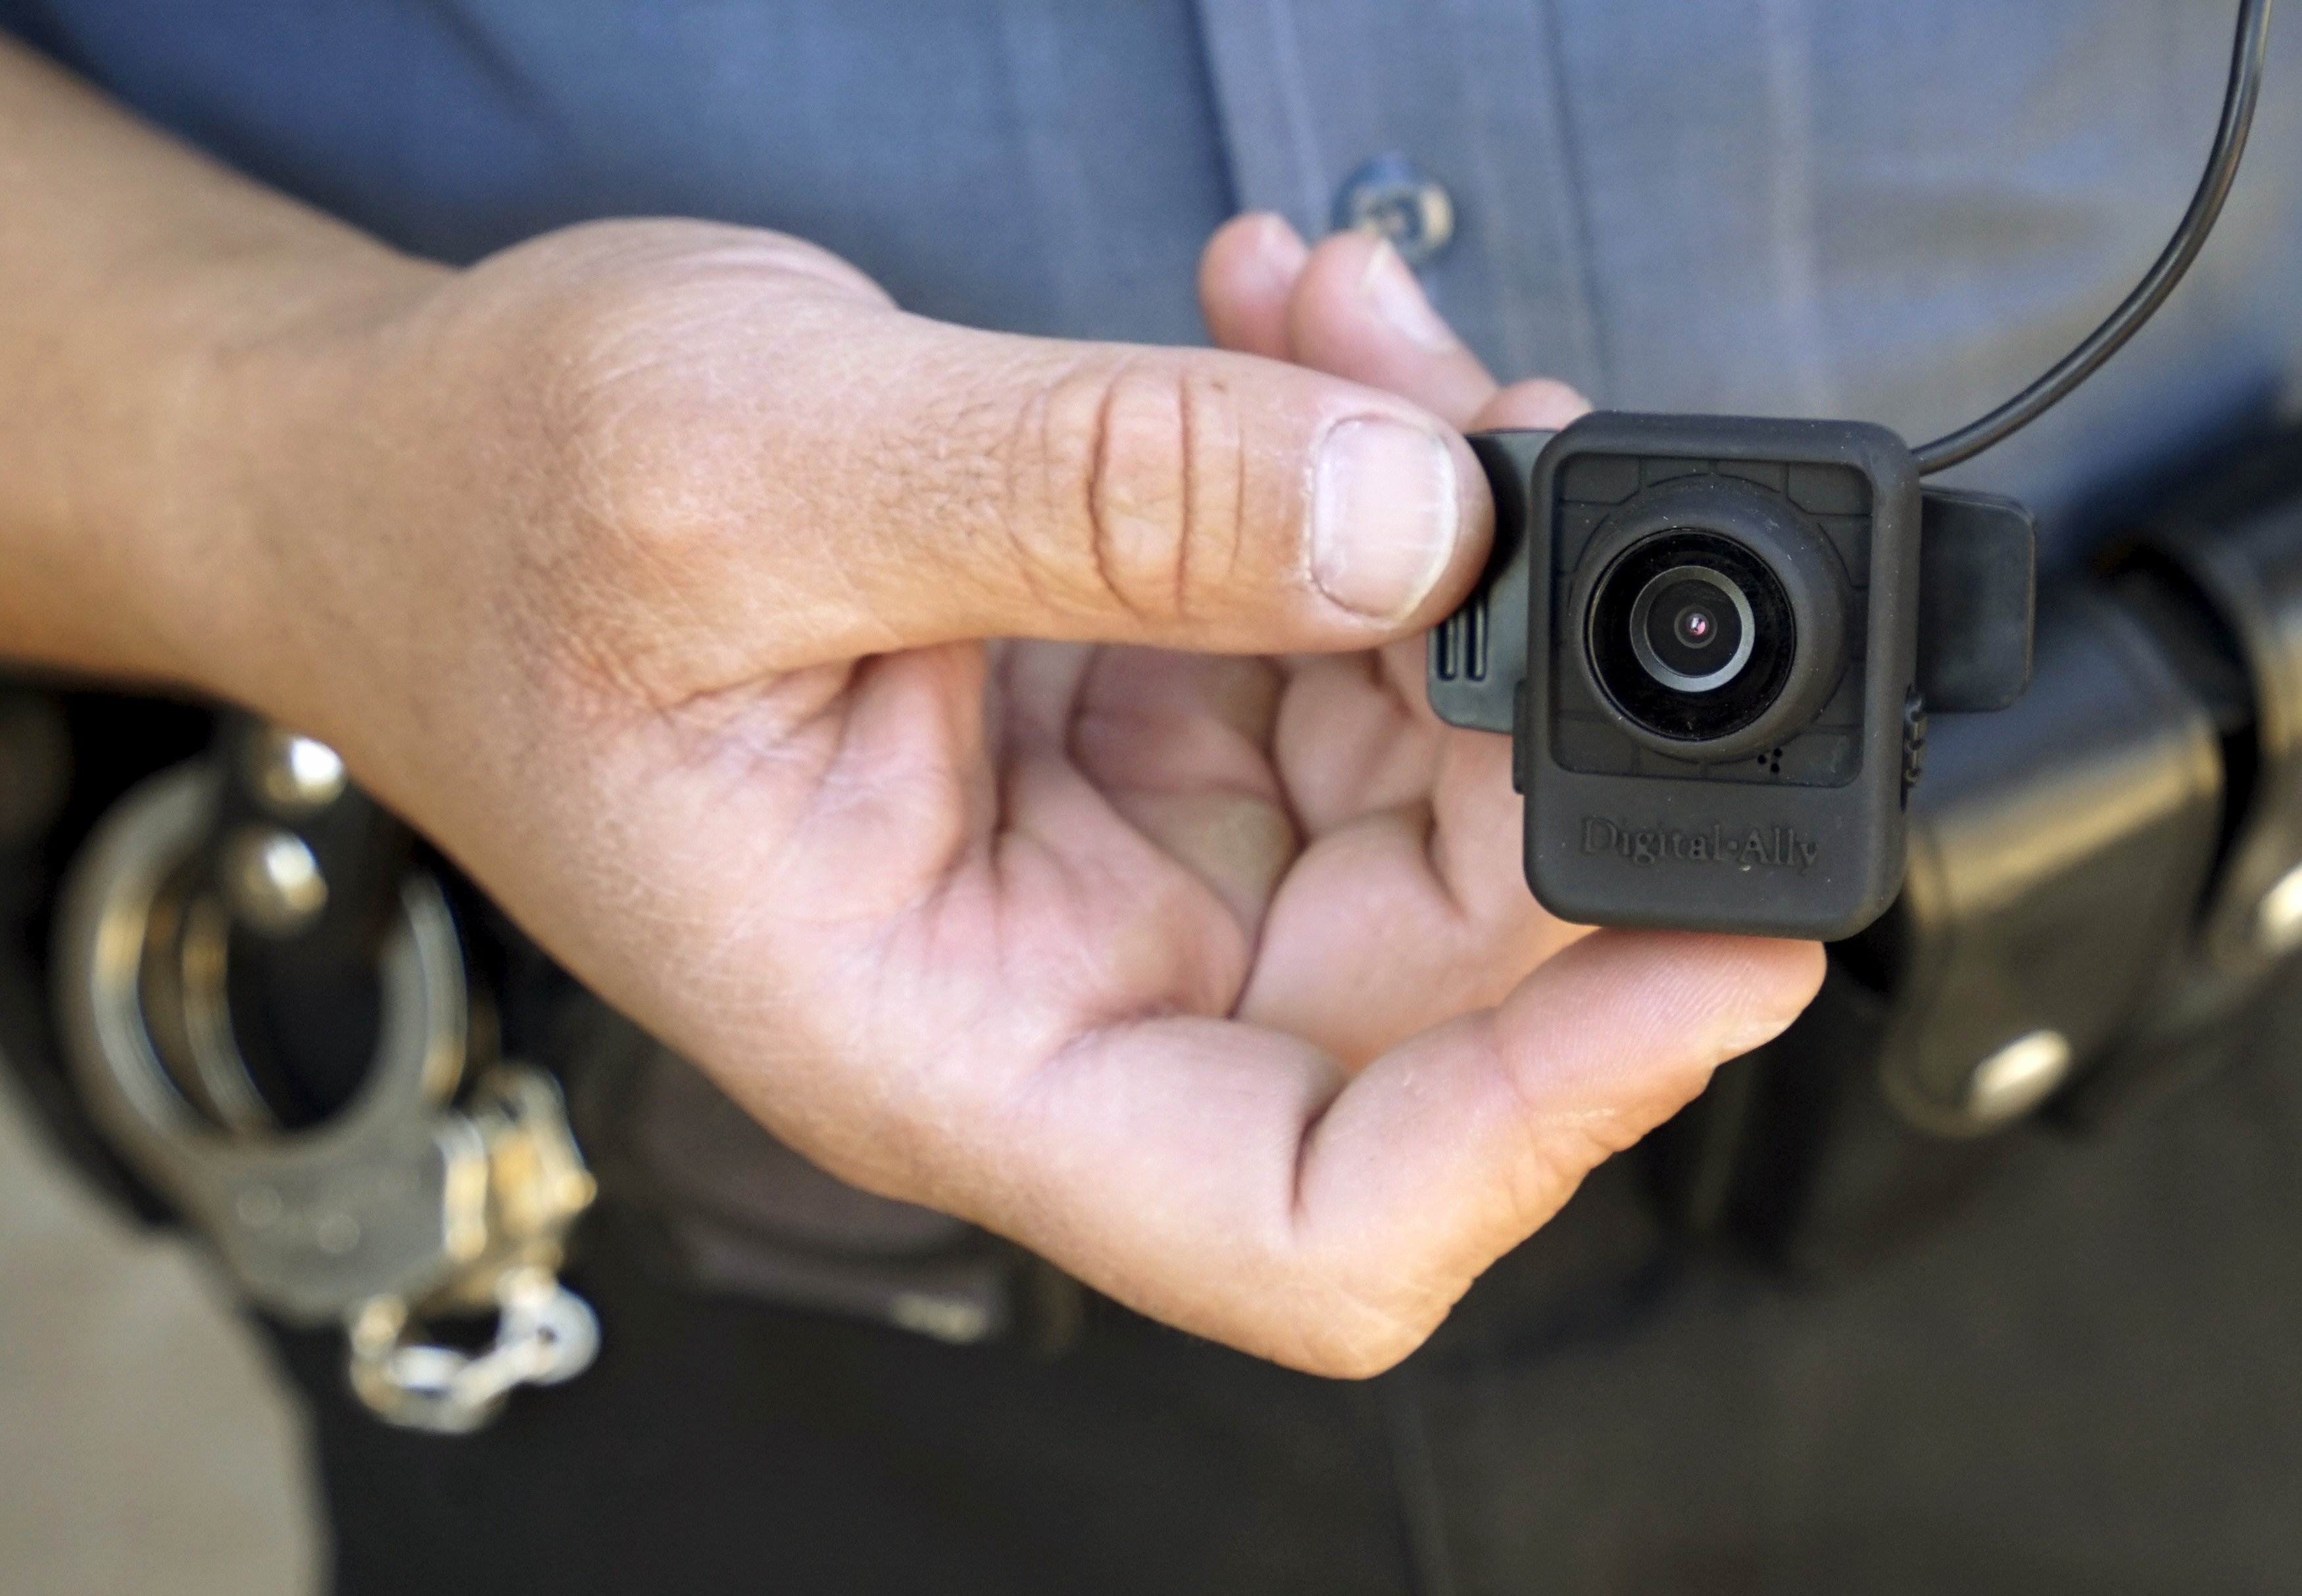
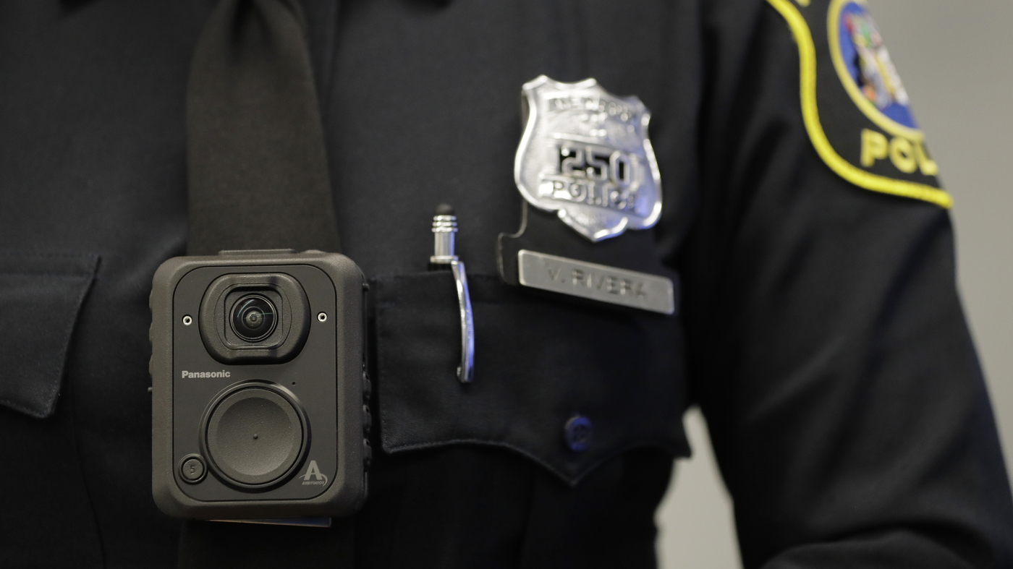
Body Worn Cameras
Pemberton Township Police Department

Slide 2
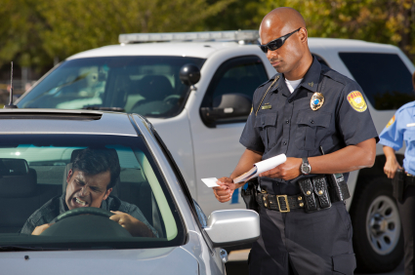
Why?
10. When suspects are told they are being recorded, they may be less likely to fight or run from officers. This is an incredibly helpful aspect of today’s body-worn cameras.
9. The cost of the units is minimal compared to the number of unfounded lawsuits that can be quashed before they are even filed.
8. Body-worn camera systems go with the officer, and, unlike dashcams, are not dependent on the officer’s proximity to the patrol car.

Slide 3
Why?
7. Body-worn camera systems do not have moving parts and tend to be very reliable.9. The cost of the units is minimal compared to the number of unfounded lawsuits that can be quashed before they are even filed.
6. Videos can be used to immediately exonerate officers in high profile incidents and improve public trust in the department.
5. A video recorder can help ensure accountability for officer conduct. This is an incredibly useful tool that can save the time and expense required for a full-blown internal affairs investigation.

Slide 4
Why?
4. Body-worn recorders help departments determine what training should be done based on how officers handle calls. In other words, departments can alter their training regimens to reflect current callouts.
3. The videos can give a jury an actual look at the crime scene as the officer found it.
2. A body-worn camera can preserve evidence from field interviews, arrests and more situations common on the job.

Slide 5
Why?
1. Video recordings protect officers from unfounded complaints.
1a. Discourage both officers and civilians from engaging in inappropriate conduct (AG Directive 2015-1, 1.2)
SOURCE: https://www.tactical-life.com/gear/10-reasons-cops-use-body-worn-cameras/

Slide 6
What Will Drive Our BWC Use….
TRAINING…

Slide 7
Training…

Slide 8
Training…
National Body Worn Camera Toolkit
https://www.bja.gov/bwc/index.html

Slide 9
Training…
Vendor Supplied Training
National BWC Training and Technical Assistance Meeting

Slide 10
And…
Policy…

Slide 11
Scorecard…

Slide 12
Policy…
National Best Practices
Office of Justice Programs (USDOJ/OJP)
IACP
Model Policies
Local Resources

Slide 13
Thank You…
Questions / Open Forum

